Slide 1
Lake Travis FFA Alumni
February 7, 2023

Slide 2
Agenda
Welcome
Review/Approval of January Minutes
Special Thanks
TCYS Update
Treasurer Report
Teacher Update
Upcoming Dates and Deadlines
New Business
Questions & Adjourn

Slide 3
Special Thanks
Eric and Lauren Vance and Family for Cantina
Cynthia Pittenger for Herdsman decorating
Shelley Judd for coordinating RVs at TCYS
Everyone who helped with TCYS set-up and herdsman decorating
Volunteers who helped with Cantina (Jason Podzemy), brought donations
Parents who helped clean animals at the barn after TCYS

Slide 4
TCYS Success
Kathleen Fisher
LT FFA Students participating TCYS this year:
50 Youth Fair Entries (11 members + one little wrangler); 43 Livestock Entries (32 members) several with multiple entries.
Amelia Eckels sang National Anthem at Auction
Youth Fair Grand Champions – Ace Frankenhauser, James Olden, Amy Salas
Livestock Highlights – Myron Smith Grand Champ Rabbits; Danny Crompton Reserve Champion Rabbits; Maya DeLeon Reserve Champion Southdown lambs; Jenna Dow 1st in class in lambs and goats; Ashley Stevens 1st in class goat; Tyler Pittenger 2nd in class goat; Bailey Sulak 2nd in class steer
More than ⅓ of project entries “made sale”

Slide 5
TCYS Success
Jenn DeLeon
TCYS Auction Dollars
$22,350 spent at auction
($20,450 for LT and $1,900 for other chapters)
$23,150 raised at auction
(Note: Board approved additional $850 in spend on-site)
$43,600 collected for LT kids!!
(22 kids / 25 projects)

Slide 6
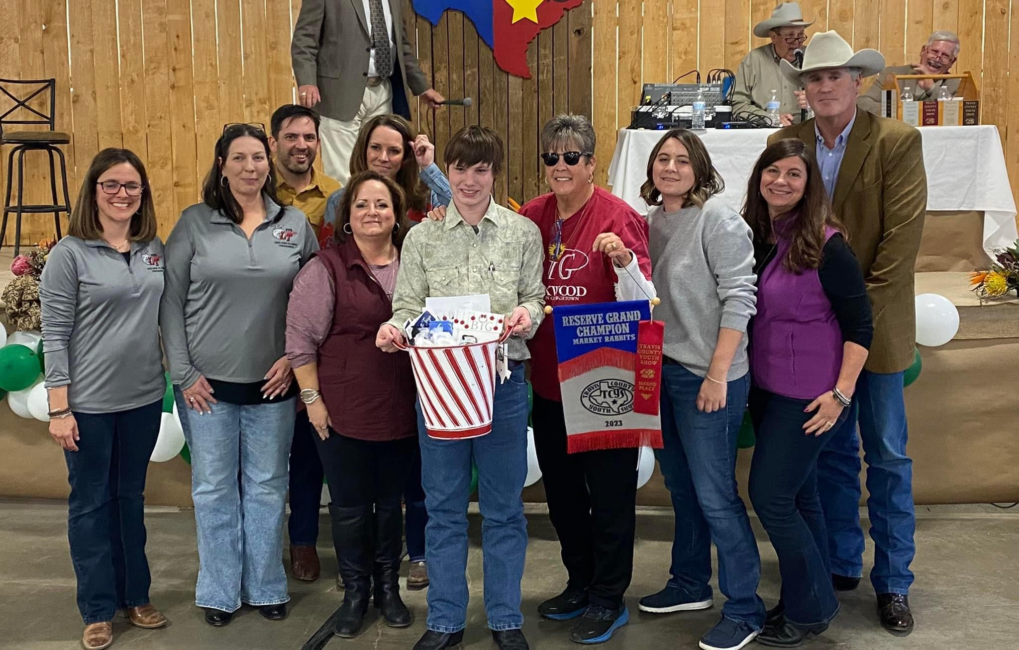
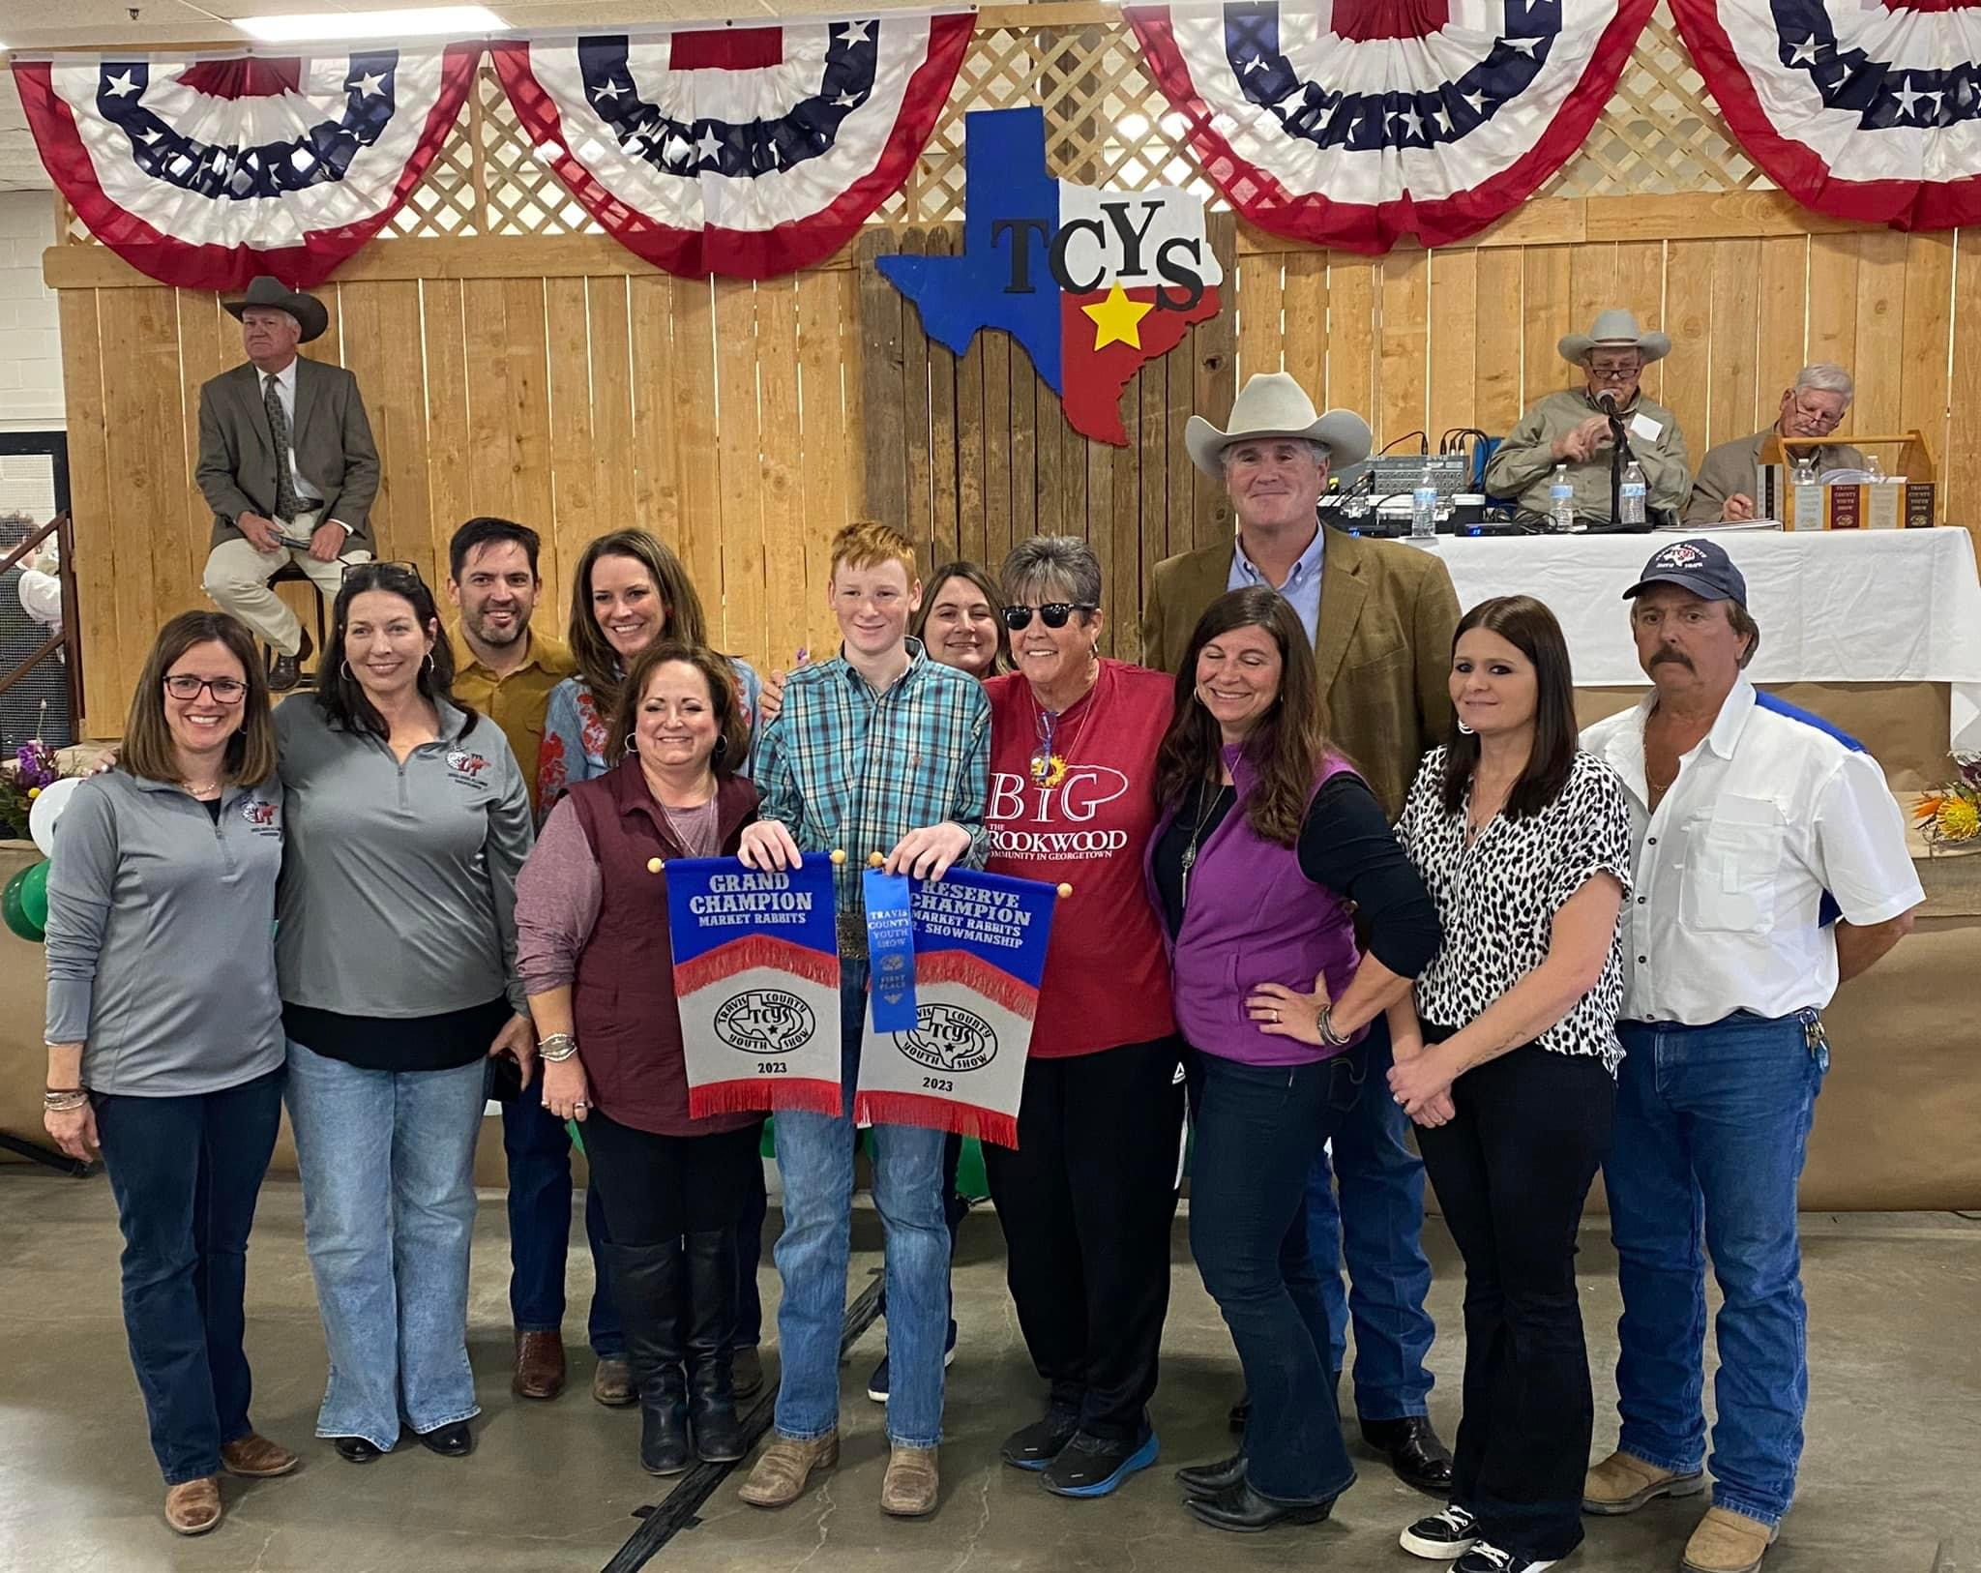
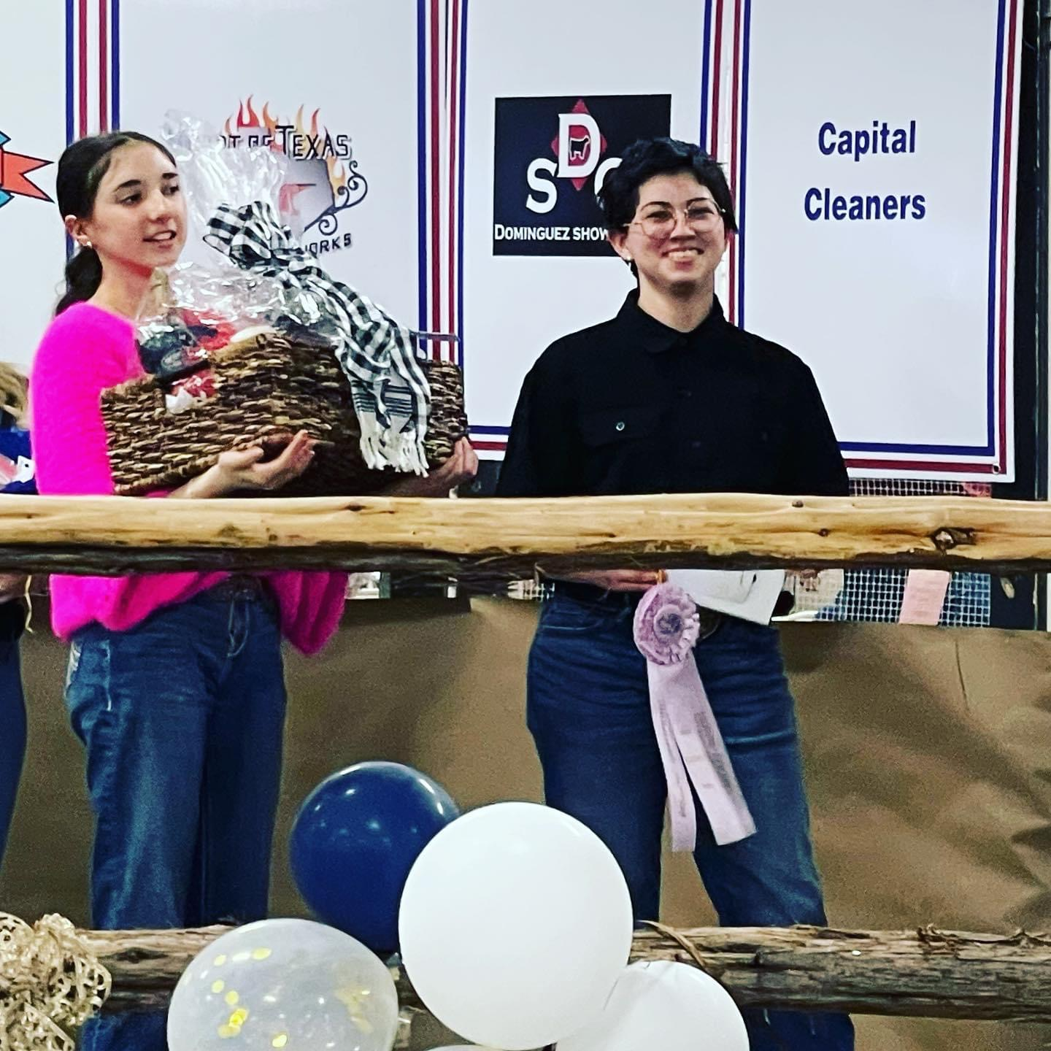
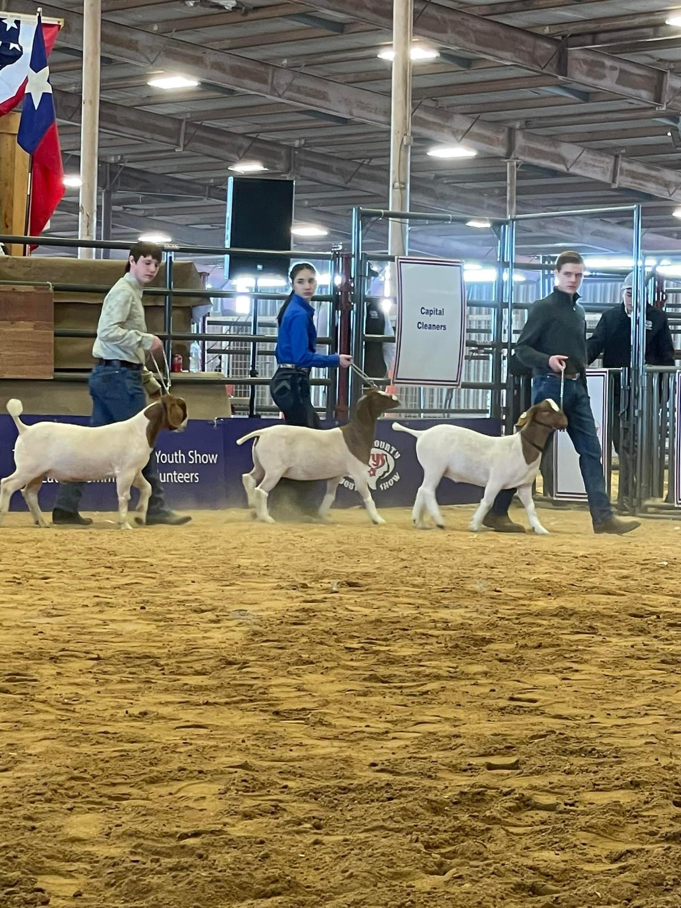
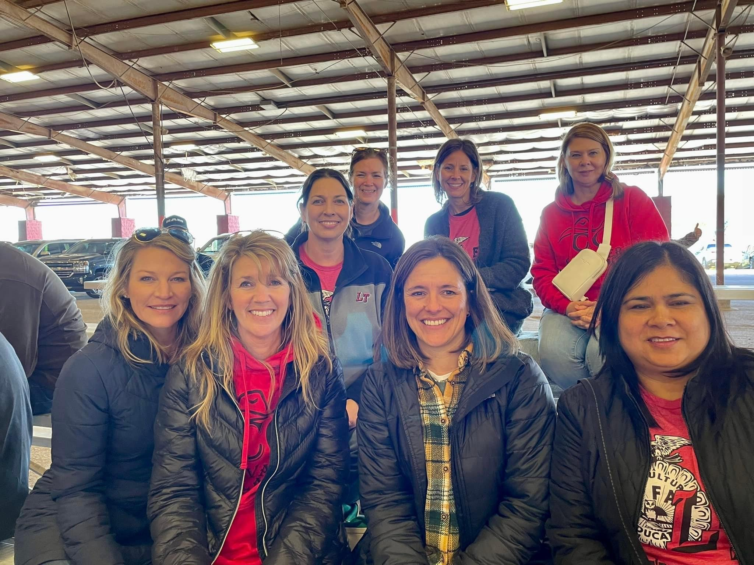
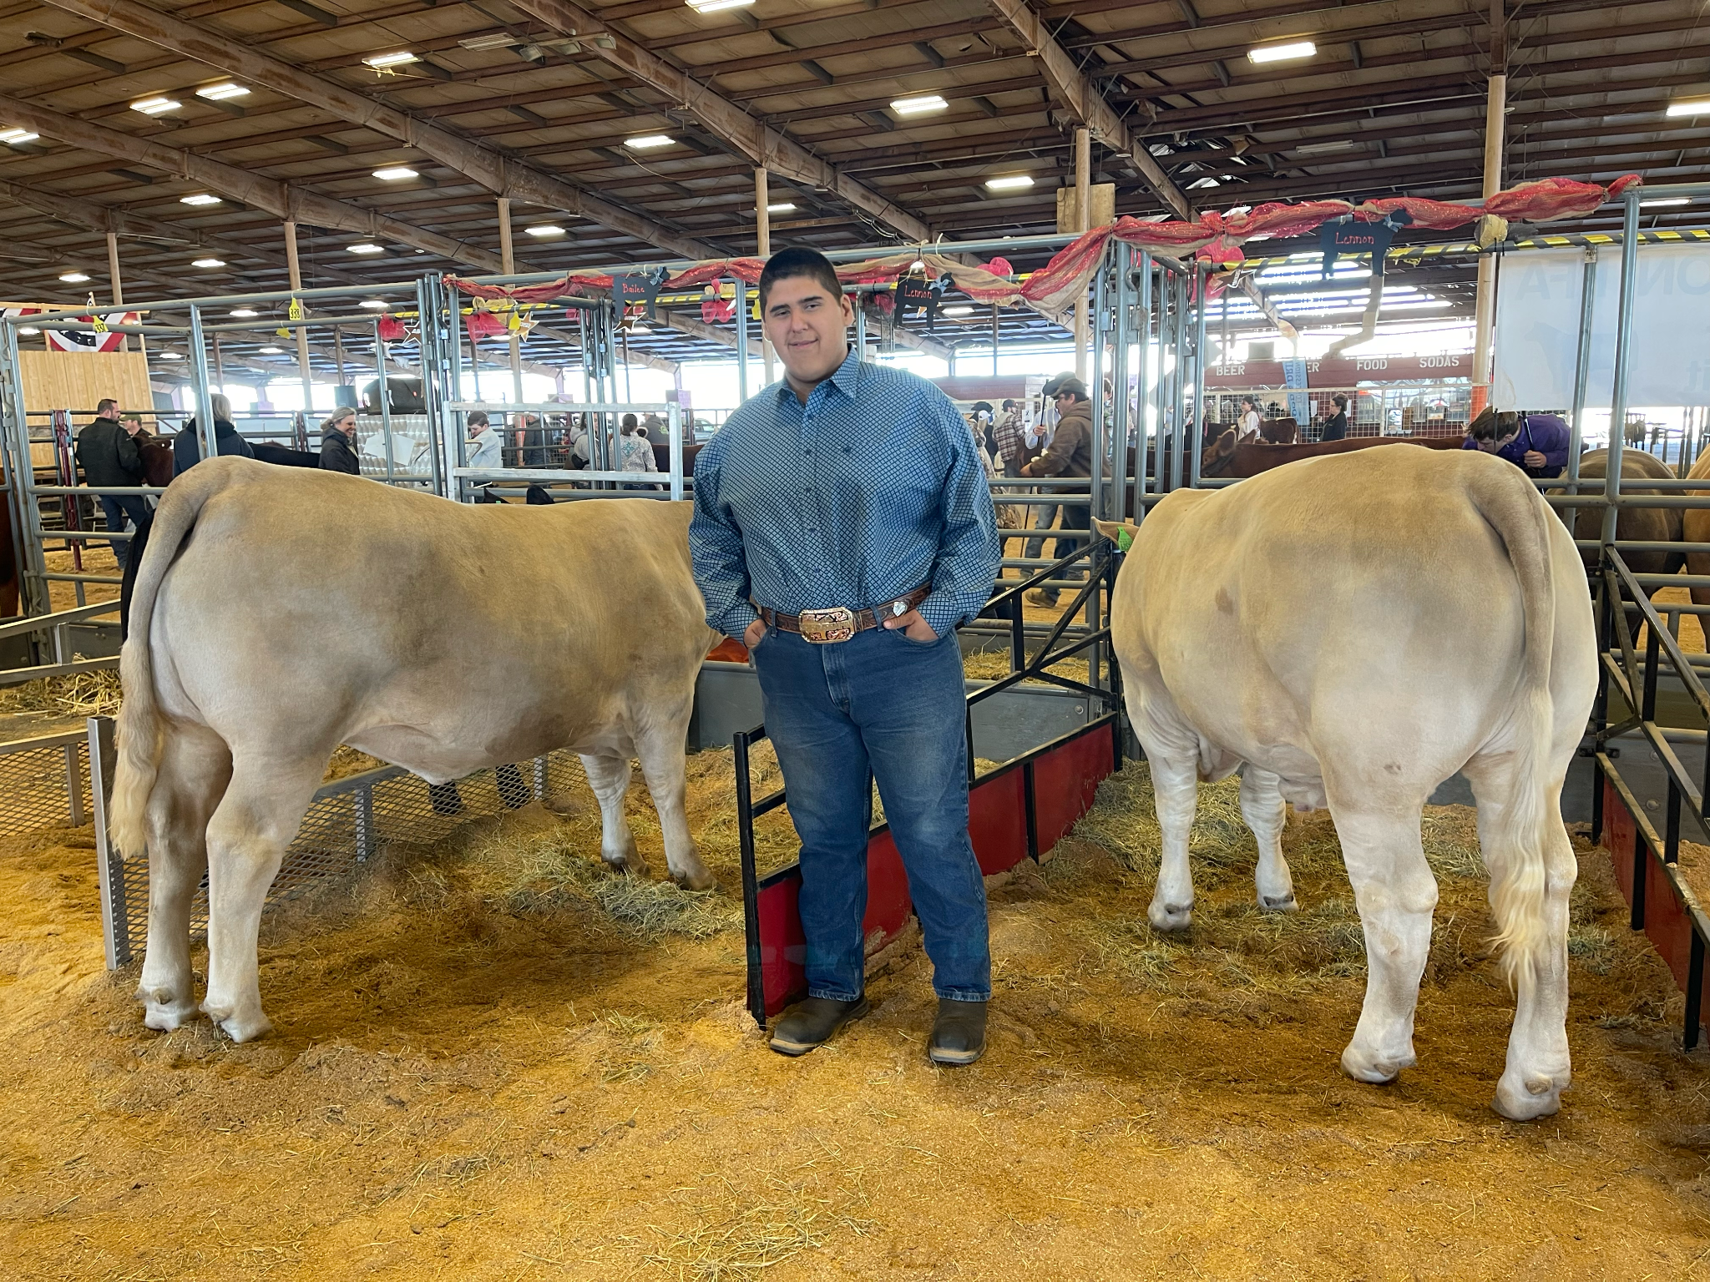
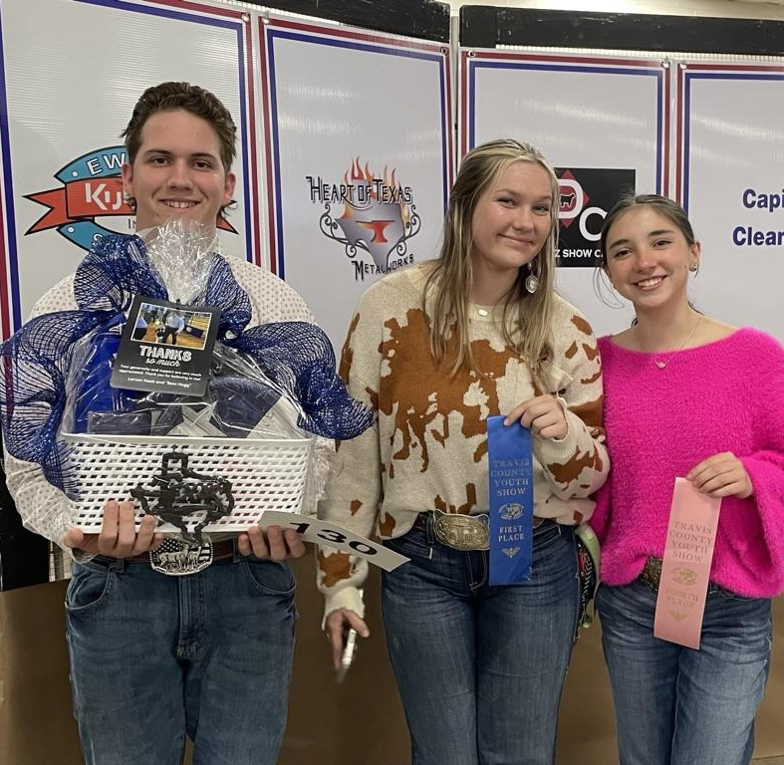
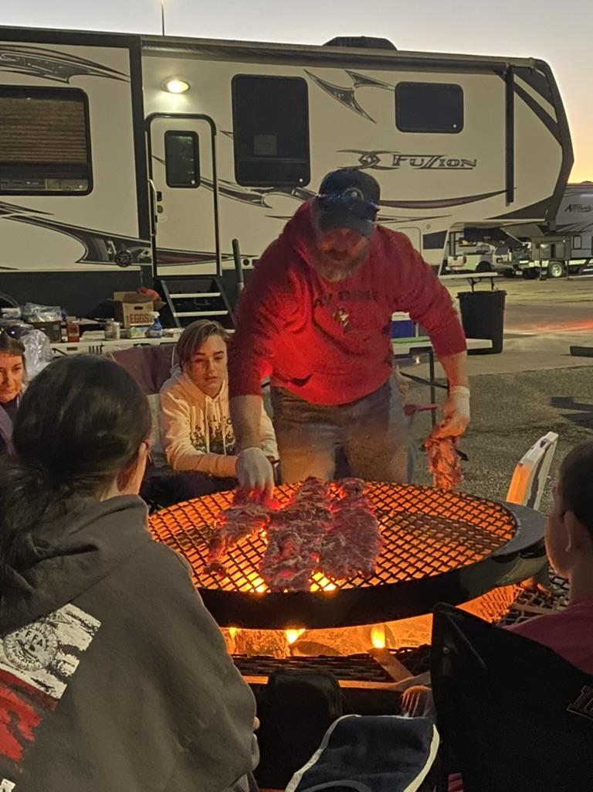
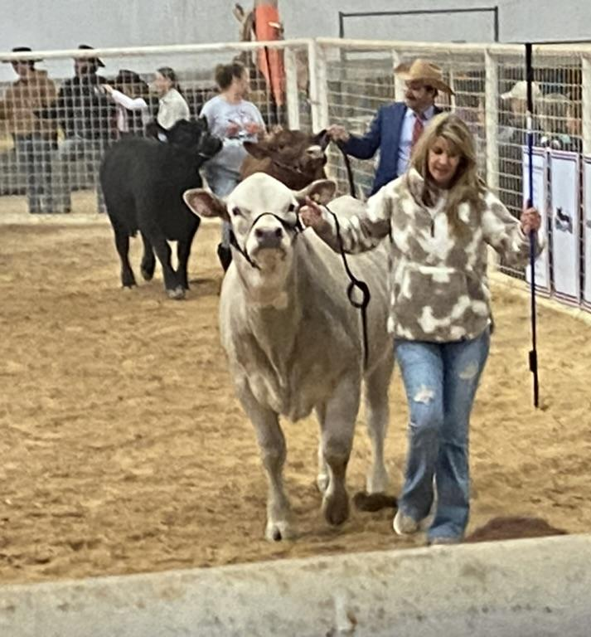
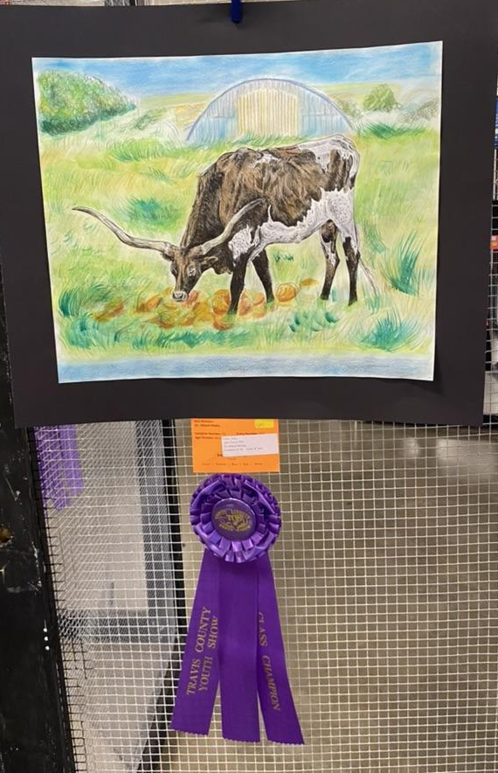
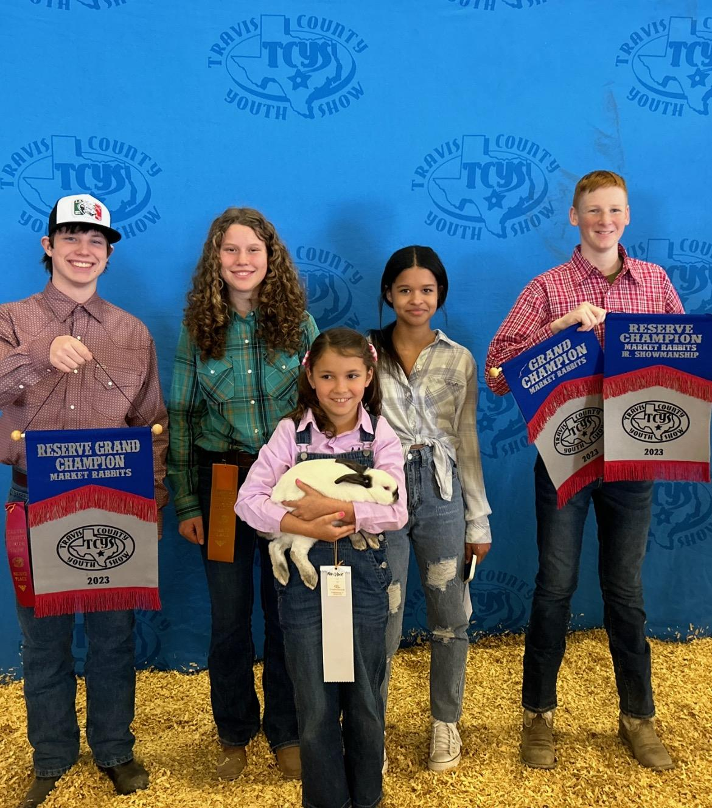
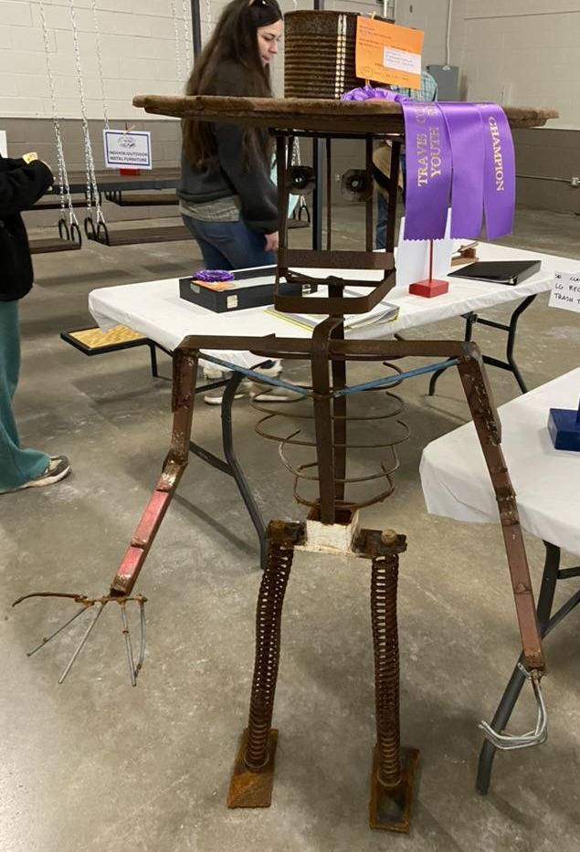
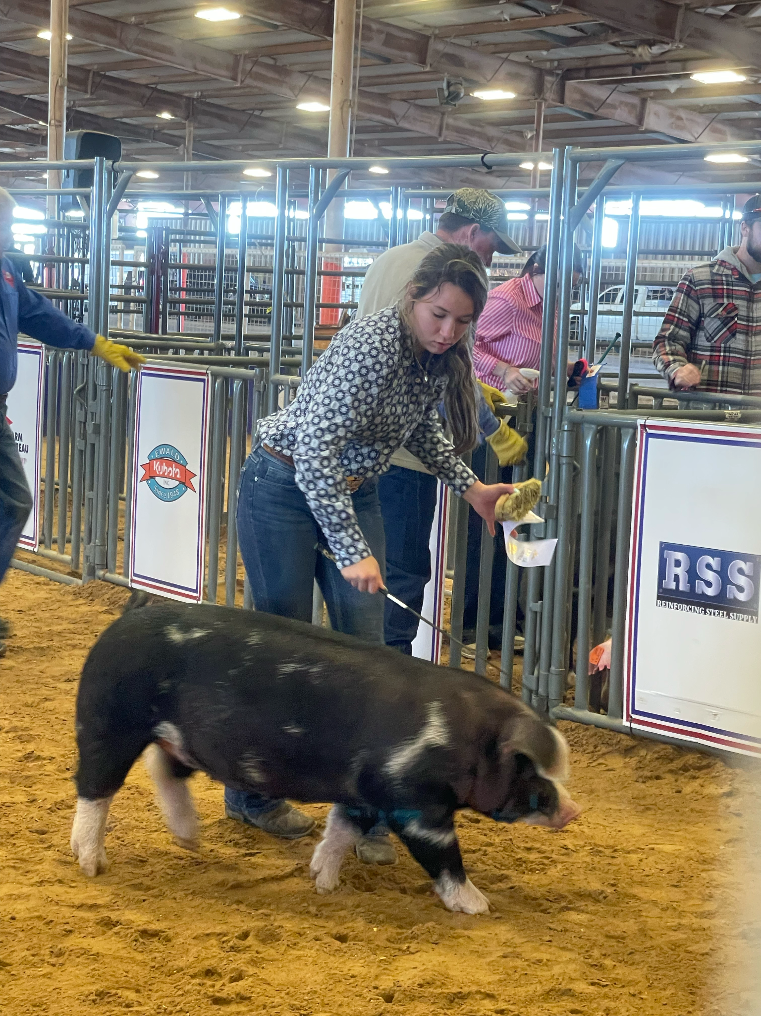
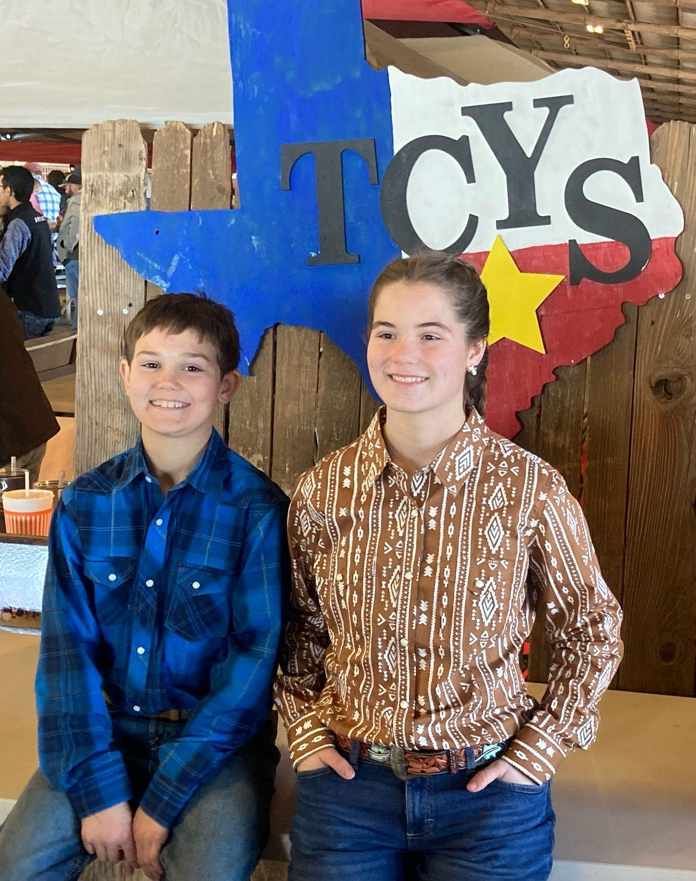
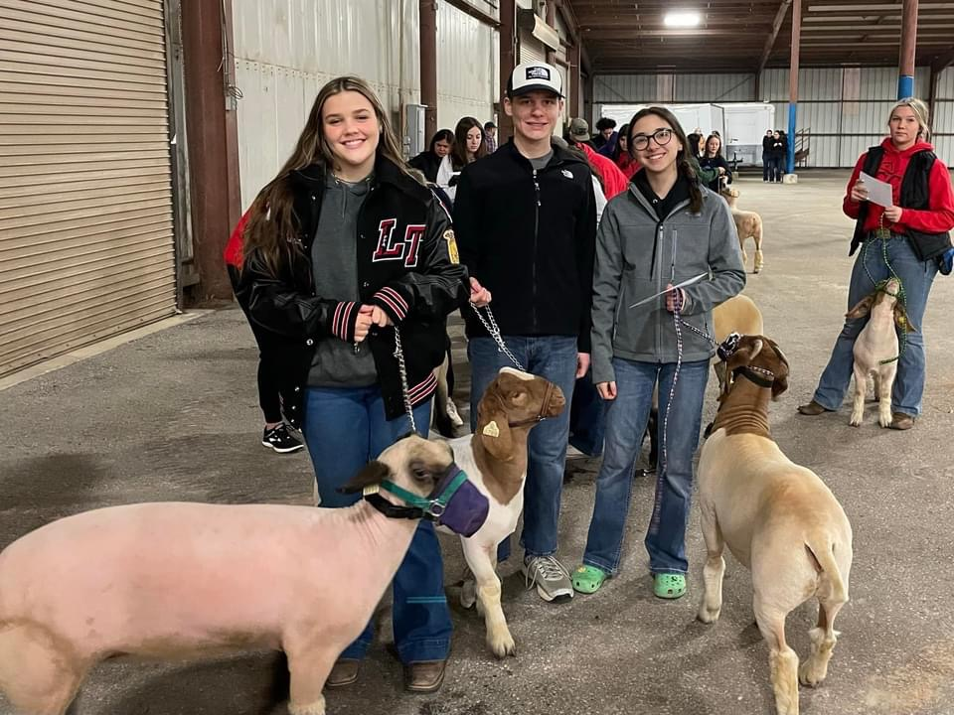
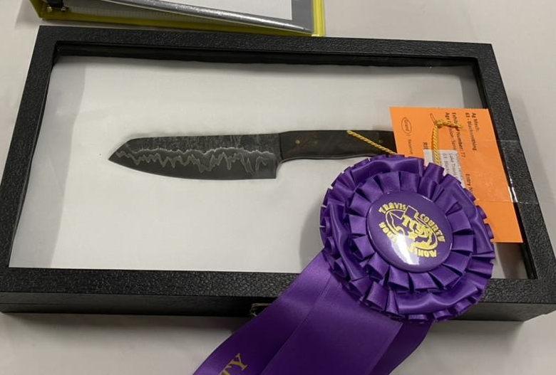

Slide 7
Treasurer’s Report
Jan. Net Cash Flow
Down $29,189.36
Expenses: $30,540.69
Operating Expenses: $31.98
TCYS: $22,466.50
Sponsorships: $152.61
Spirit Wear: $1,717.50
Other: $6,172.10
Income: $1,351.33
Other: $1,351.33

Slide 8
2022 - 2023 LT FFA Sponsors
Thank you!!
Diamond Level
H&H Ranch Lakeway
Pittenger CPA
Wild Hare Construction
Titanium Level
Bosque River Construction
The Crompton Family

Slide 9
2022 - 2023 LT FFA Sponsors
Thank you!!
Platinum Level
Lakeway Veterinary Clinic
The Foxx Family
Gold Level
Oil Patch Gear
Papa Murphy’s - Lakeway
Personal U
Shipp Family Dentistry
Spicewood Vet Clinic

Slide 10
2022 - 2023 LT FFA Sponsors
Thank you!!
Silver Level
A+ Federal Credit Union
Bella Vida Logistics
Heaven’s Best Carpet Cleaning
Incavo
It’s All Good BBQ
Jason Podzemny, Realtor
McCoy’s Building Supply
Nitro Swimming
Raising Cane’s
Reata Insurance Group
Rudy’s Country Store & BBQ
Starfish Home Staging & Redesign
The Vance Family
The Wise Family
Turtle Trucking
Watkins Insurance Group
Wildlife Management Services
Zilker Media

Slide 11
2022 - 2023 LT FFA Sponsors
Thank you!!
Bronze Level
Ben Archer - State Farm
Chick-fil-A - Lake Travis
China Steakhouse
Evans Livestock
Flipnastics
Kendra Scott
La Cabana Grill
Lakeway Vision Associates
Malco Electric
The Allmand Family
VIK Complete Care

Slide 12
Teacher Update
P. White/ K. White
LDEs Dairy Cattle, Livestock, Poultry, and more
SDEs - Public Speaking Contest
Encourage your kiddo to get involved!

Slide 13
Teacher Update
San Antonio Stock Show Details
Lambs ~ Load up/out 4 AM on 2/13
Goats ~ Load up/out 4 AM on 2/13
ALL SHOW on 2/14 (Medium Wool on 2/15)
Mr. K White DID NOT book rooms.He is staying at the Staybridge Suites Airport
Pigs Round 1 Berk, Hamp, Spot, Duroc
Load at 5pm Thursday 2/16 (tentative)
Pigs Round 2 Yorks, Crosses
Load at 5pm Sunday 2/19(tentative)
Transportation-parents are responsible for student transportation
Be sure to book your hotel room!

Slide 14
What are the kids talking about…?
Major Shows
TCYS Results
Planned absences
CDE’s ~ Career Development Events (aka Judging Contest)
SDE’s - Speaking Development Events -
FFA Talent Contest
Record Books -
2023-2024 FFA Officer Election Process
PHOTOS FOR END OF YEAR SLIDESHOW
Mandatory Barn Clean Up
Removal of animals from barns
Suggestions for future volunteerism and bonding events

Slide 15
Upcoming Dates & Deadlines
P. White/ K. White
Two weeks after your last show = animals out of barn
February 13-23 = San Antonio Stock Show
March 7 = next Alumni meeting (board nominations)
April 1 = Area XII CDEs
April 3 = Pet Shot Clinic
April 3 = P Terry’s Spirit Night
April 15 = Scholarship Applications Due
TBD = Barn Clean-up
May 5 = Banquet

Slide 16
New Business
Kathleen Fisher
Buyer Events/Sponsors Critical to Success
Cav Classic 2023: October 28, 2023
current board recommends it for next year fundraiser
needs a chair/committee members
Fundraising - Kendra Gives Back – should we do a spring??
2023-2024 Board Elections
Written nominations collected in March
Vote in April (written ballot or survey monkey)
Fundraising Chair/Cav Classic Chair needed at this time

Slide 17
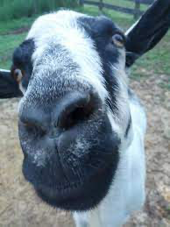
Goat Any Questions?

Slide 18
Next Meeting March 7 (6pm)
Meeting
Adjourned
Thank you for attending!

